Slide 1
Smart Hospital -CSE A
CB.EN.U4CSE18012 Nikhitha Chavalam
CB.EN.U4CSE18037 Nishita Dash
CB.EN.U4CSE18041 Parripati Divyasri
CB.EN.U4CSE18042 Parvana J Kuruppal
CB.EN.U4CSE18502 Hridhi Sethi

Slide 2
Project Analysis- Abstract
The idea here is to provide a platform to make health care system more manageable and accessible for the patients ,doctors and staff by maintaining a comprehensive database. Maintaining proper health records ,test reports, prescription on a single platform makes the running of the system in place more effective and hazzle free. Being DBMS based makes the updating, retrieval , backup etc of data easier in turn helping the doctors make timely and effective diagnosis. Online appointment system involved here helps save time and makes the actual process easier for the staff

Slide 3
Project Analysis
1) Patient_consults_doctor
2) Patient_views_test_report
3) Patient_explains_diagnosis
4) Patient_gives_medical_history
5) Patient_tells_insurance
6) Patient_requests_appointment
7) Doctor_sets_appointment
8) Person_login
9) Branch_person
10) Branch_has_inventory
11) Branch_available_medicine
12) Test_req_inventory
16) Patient_gets_prescription (on the basis of test report , medical history , diagnosis )
17) patient_Pay_bills
.

Slide 4
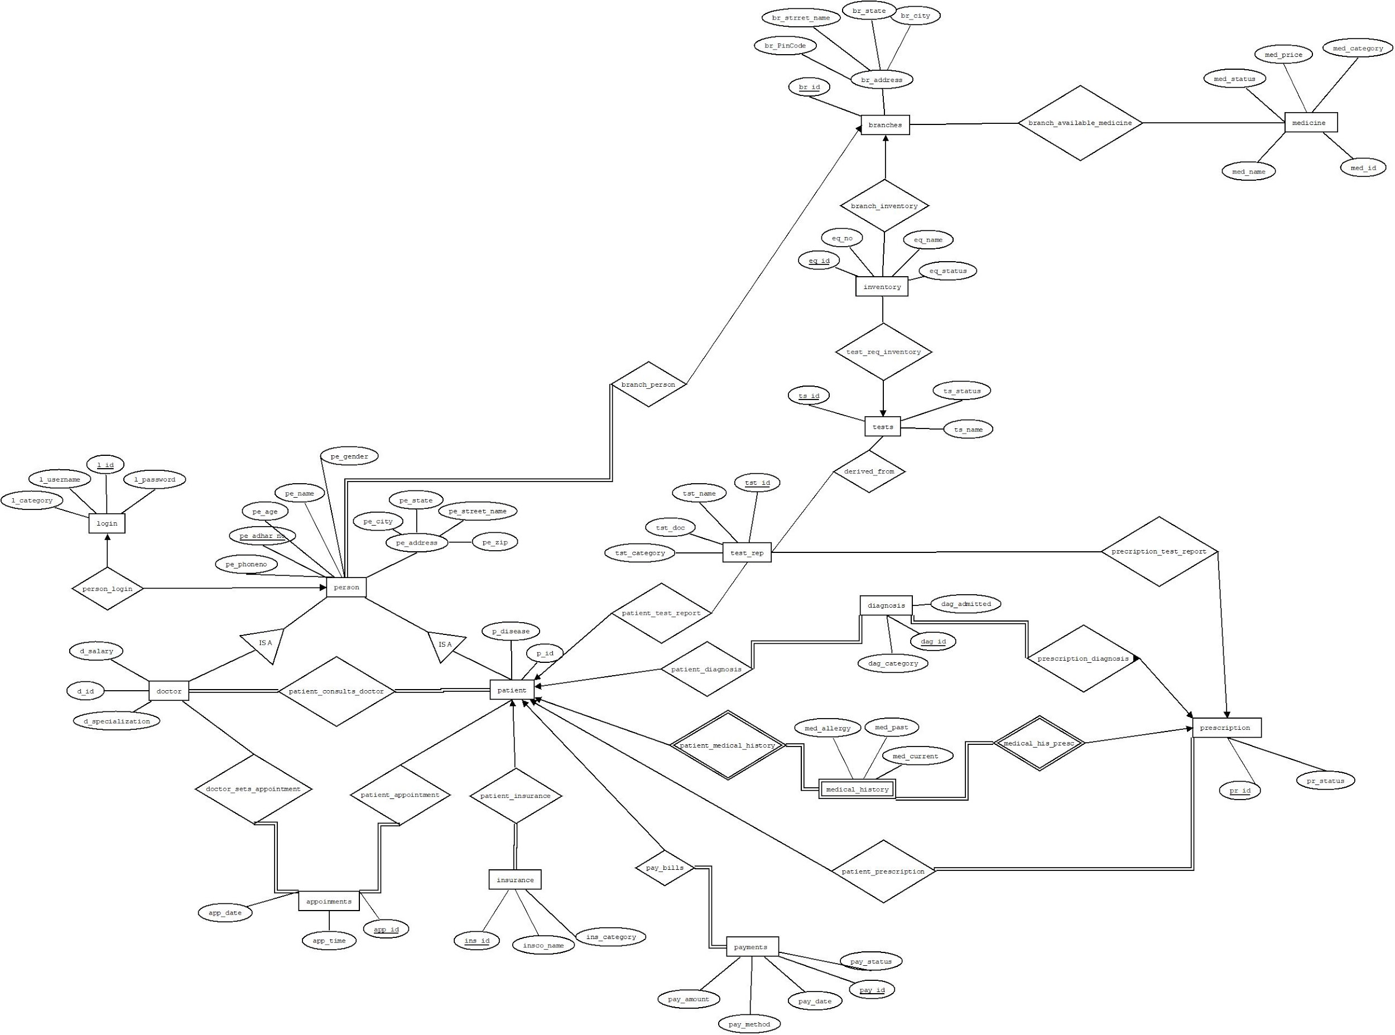
Project Design-ER diagram

Slide 5
Demonstration…

Slide 6
Conclusions
We have build a website that manages data and provides a certain collection of functionalities to patients, doctors and staff of a particular hospital group. We acheived the objective that is to make tasks such as making appointments, viewing past health records ,updating records, viewing prescriptions and test results, checking availability of prescribed medicine etc possible from the comfort of their homes. Similarly doctors can view or modify their schedules, view their patient ‘s records and test results on this platform.

Slide 7
Thank you

